Slide 1
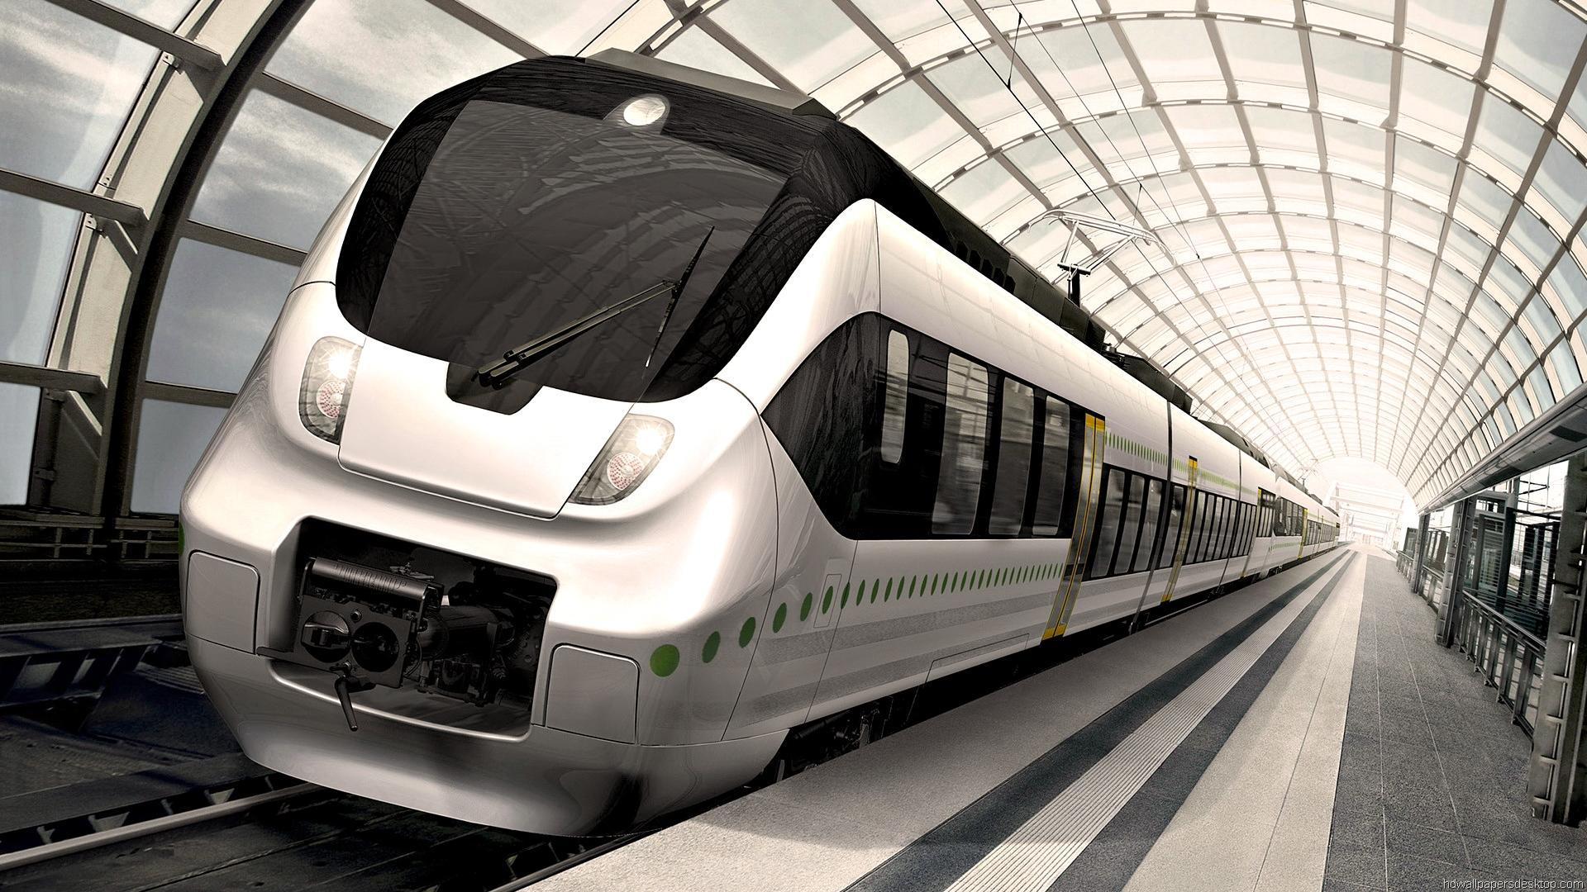
Metro Manufacturing
Case Study #10
Muhammad Sabir
Hikmatullah Nasiri
Abdiweli Mohammad
Ibrahim Shehu Sagagi
Devin Yasas

